Slide 1
Friday Training Hour
“Python 101”
+ Best Practices
Anthony McKale Principal Engineer &
Jonathan Osborne
AI CoE Developer 12/03/2021

Slide 2
Python 101
DISCLAIMER: This is based off Jonathan previously talk from a year ago
It’ll cover Installation, Training, Best Practice, python No-Nos
Information classiﬁcation: Public

Slide 3
Python 101 : What is Python?
FOR INTERNAL USE ONLY
“Python is an interpreted, high-level, general-purpose programming language. (…)” “Python’s design philosophy emphasises code readability with its notable use of significant whitespace. (…)” “(designed for) writing clear, logical code for small and large-scales projects.”
Wikipedia:
https://en.wikipedia.org/wiki/Python_(programming_language)
Information classiﬁcation: Public

Slide 4
Python 101: History
Born in the late 80’s by a chap called “Guido”
Named after Monty Python’s Flying Circus
Python 2.0 came out in the 2000 marks the modern version of the programming language aka garbage collection, character set support, etc
Python 3.0 came out in 2008 modern version of the programming language aka typing, better modules / classes, string interpolate, etc
Strange high level language, that been be compiled for low level performance
Information classiﬁcation: Public

Slide 5
Python 101: History
Adopted as main shell language for Apple
Adopted as the language of choice by Data Scientists
Adopted by AI CoE as “hardcode” heavy lifting language (with Node being our go to boiler plate / app language)
Information classiﬁcation: Public

Slide 6
Versions: Python-Versions...
FOR INTERNAL USE ONLY
Getting into python it isn’t long before you run into python’s different versions…
Python 2
Python 3
vs
Information classiﬁcation: Public

Slide 7
Versions: Python 2 /Python 3 a comparison
FOR INTERNAL USE ONLY
Legacy – still entrenched in lots of old software
Library – many old libraries are not forwards compatible
ASCII – Strings are stored as ASCII by default
5/2 = 2 – Integer calculations are rounded down
Print “hello world” – print in python 2 style
Future – It is slowly but surely taking over
Library-most new libraries are not developed with backwards compatibility using tech only in python 3.
Unicode – Strings are in Unicode by default
5/2 = 2.5-The expression will return the expected result
Print (“Hello World”)
Note – Node gyp wraps gyp written in python 2, so you need python 2.7 for some packages in npm however nothing to stop you having both installed – more later.
Information classiﬁcation: Public

Slide 8
Versions: Overview
FOR INTERNAL USE ONLY
Use PYTHON 3 simples ☺
PYTHON 2 is dead
Information classiﬁcation: Public

Slide 9
Python Installation: interpreter
“xxxDELETEDxxx”
Information classiﬁcation: Public

Slide 10
Python Installation: Pip Modules
pretty much every language has a package manager and python is no exception, it’s called PIP
“xxxDELETEDxxx”
Information classiﬁcation: Public

Slide 11
Python Primer: 101
FOR INTERNAL USE ONLY
Now for a basic 101 python
Information classiﬁcation: Public

Slide 12
Python Primer: JS (Node) and Python
FOR INTERNAL USE ONLY
Node | Python
Python is a scripting language Deployable as driver, desktop and web applications. ( Even your BT set top box or router) | JS primarily a web programming language Deployable via browser, or as server application side via Node JS
Python has a comprehensive standard library (like Java) | JS has a very limited set of utility objects.
Python uses a true class based inheritance model | Node has a limited by functionality class based inheritance model (missing abstract / interfaces… cough cough)
Strings in python are immutable | So are strings in JS
Information classiﬁcation: Public

Slide 13

Python Primer: Hello World
FOR INTERNAL USE ONLY
Easy right ?
Information classiﬁcation: Public

Slide 14
Python Primer: Primitives
FOR INTERNAL USE ONLY
Now will go over some of those built in data types spoken about previously
Read stdtype docs for more info
See https://docs.python.org/3/library/stdtypes.html
Information classiﬁcation: Public

Slide 15

Python Primer: Boolean Primitives
FOR INTERNAL USE ONLY
Boolean
Treat None like “undefined” in Node
See https://docs.python.org/3/library/stdtypes.html
Information classiﬁcation: Public

Slide 16
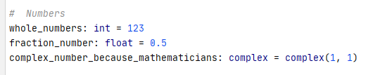

Python Primer: Number Primitives
FOR INTERNAL USE ONLY
Number
Int and floats are very different so be careful
Also remember like Node, Python can’t count
See https://docs.python.org/3/library/stdtypes.html
Information classiﬁcation: Public

Slide 17
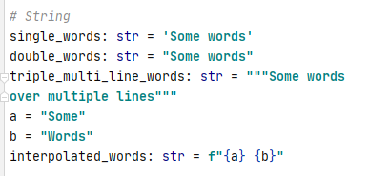
Python Primer: String Primitives
FOR INTERNAL USE ONLY
String
See https://docs.python.org/3/library/stdtypes.html
Information classiﬁcation: Public

Slide 18
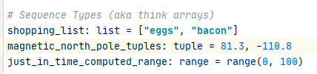
Python Primer: Sequence Primitives
FOR INTERNAL USE ONLY
Sequences
Remember Tuples great for generics and putting into lists
Remember ranges are super efficient (and just in time calc-ed)
See https://docs.python.org/3/library/stdtypes.html
Information classiﬁcation: Public

Slide 19
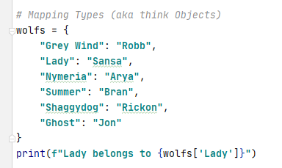
Python Primer: Mapping Primitives
FOR INTERNAL USE ONLY
Dict == Dictionary
Remember you need to access via angle brackets dict[“KEY_NAME”]
See https://docs.python.org/3/library/stdtypes.html
Information classiﬁcation: Public

Slide 20
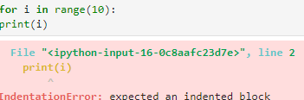
Python Primer: Important Notes
FOR INTERNAL USE ONLY
Unlike Arrays and Object in Javascript….
{} – They call this dictionary not an object
[] – And this is a List not an array
Whitespace is really important
Though as we will mention later you should have a linter running on save so you never have to worry about this
Information classiﬁcation: Public

Slide 21
Python Primer: Primitives Overview
FOR INTERNAL USE ONLY
It’s close enough to Javascript to be easy to pickup
It’s close enough to Javascript to make silly mistakes
So be careful ☺
Information classiﬁcation: Public

Slide 22
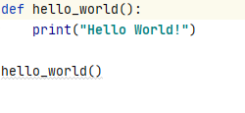
Python Primer: Function
FOR INTERNAL USE ONLY
Easy right ?
Watch out, always use spine_case not camelCase
Information classiﬁcation: Public

Slide 23
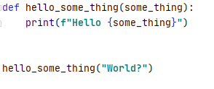
Python Primer: Function Parameters
FOR INTERNAL USE ONLY
Parameters should be spine_case too
Ps: For strings you can also do interpolation using f“{xxx}”
Information classiﬁcation: Public

Slide 24
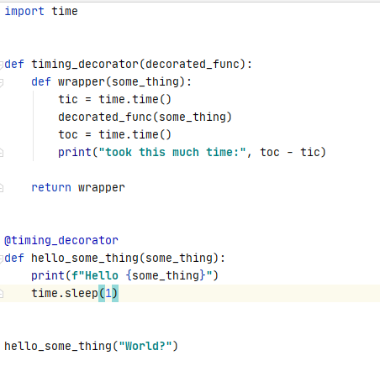
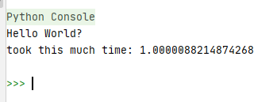
Python Primer: Function Decoration
FOR INTERNAL USE ONLY
You can wrap functions easily with decorators
Information classiﬁcation: Public

Slide 25
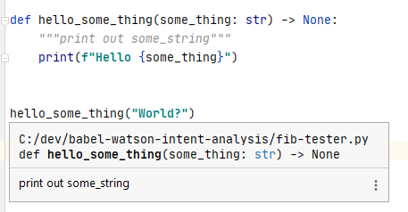
Python Primer: Function DocString
FOR INTERNAL USE ONLY
For documenting your code
“““documentation”””
Use typing as well to improve your self documenting code
Ps https://www.python.org/dev/peps/pep-0257/ for more info
Information classiﬁcation: Public

Slide 26
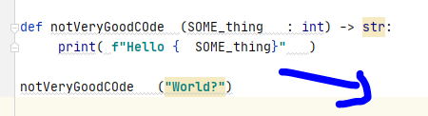
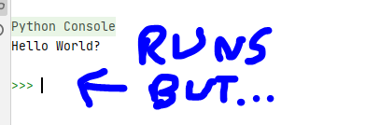
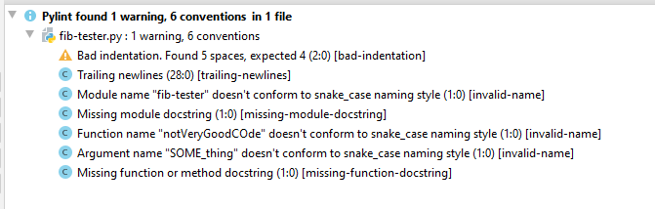
Python Primer: Code Styling
FOR INTERNAL USE ONLY
For use pylint for all code so it follow python’s commonly agreed styling
Ps https://www.python.org/dev/peps/pep-0008/ for more info be sure to read allegory “A Foolish Consistency is the Hobgoblin of Little Minds”
Information classiﬁcation: Public

Slide 27
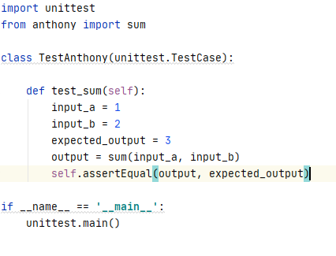
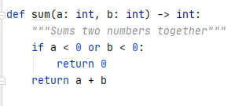
Python Primer: Code Testing
FOR INTERNAL USE ONLY
For use pytest or unittest for all cod, aim for 80% coverage
Ps https://docs.python.org/3/library/unittest.html for more info
Information classiﬁcation: Public

Slide 28
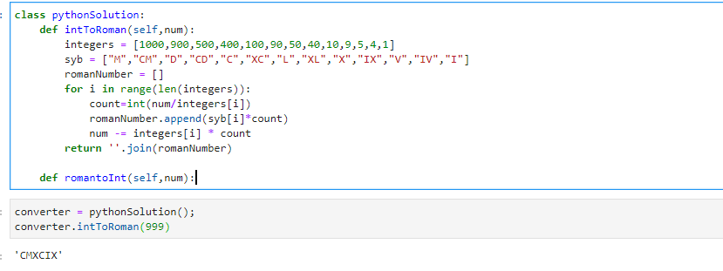
Python Primer: Sample App
FOR INTERNAL USE ONLY
Roman Numerals converter
Information classiﬁcation: Public

Slide 29
Python Primer: Questions ?
FOR INTERNAL USE ONLY
5 min break for questions
Ps best practice for Python at Natwest is hosted on confluence here xxxDELETEDxxx
Information classiﬁcation: Public

Slide 30
Python: Development Locally
FOR INTERNAL USE ONLY
Remember I mentioned linting on save? Yes I have brought another talk around to VS Code.
Visual Studio has excellent python support.
Anthony Comment:
Obviously IntelliJ is superior to VSCode in every way but Jonathan will try to now convert you from our lord and saviour the one true IDE
Information classiﬁcation: Public

Slide 31
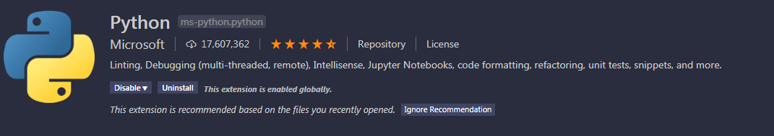
Python: VS Code
FOR INTERNAL USE ONLY
To get started install the above package – note it includes unit test support, linting and debugging out of the box.
Information classiﬁcation: Public

Slide 32

Python: Multiple Environments
FOR INTERNAL USE ONLY
As mentioned previously sometimes you need python 2.7, sometimes I use my anaconda distribution 3.7, sometimes I want to try out 3.8. But how to manage all of these together?
Python environment are a advanced topic by VS Code makes it easy: Note this button:
Clicking this allows you to choose you python environment within VS code.
Information classiﬁcation: Public

Slide 33

Python-VS Code-Features
FOR INTERNAL USE ONLY
Jupiter notebooks in VS code
Linting with minimal config – pylint is the default linter and is a good choice, flake8 is my personal favourite but haven’t bothered to set it up at work.
Information classiﬁcation: Public

Slide 34
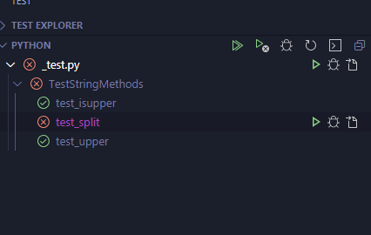
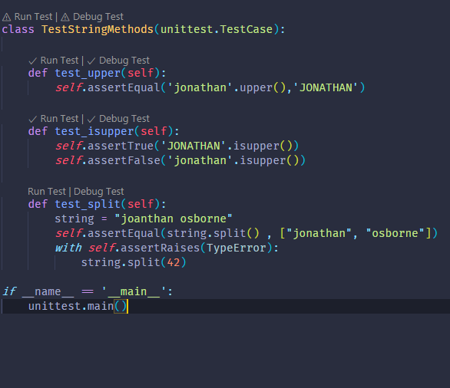
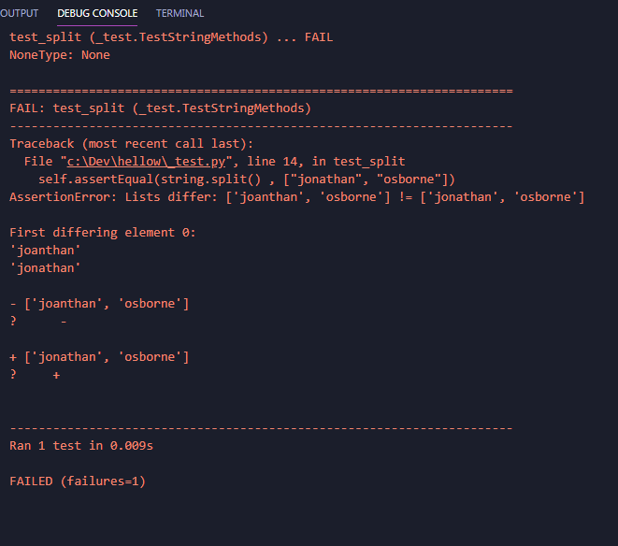
Python VS Code: Unit Testing
FOR INTERNAL USE ONLY
Write unit tests using best package (Pytest) or built in Unitest is also not at all bad.
Information classiﬁcation: Public

Slide 35
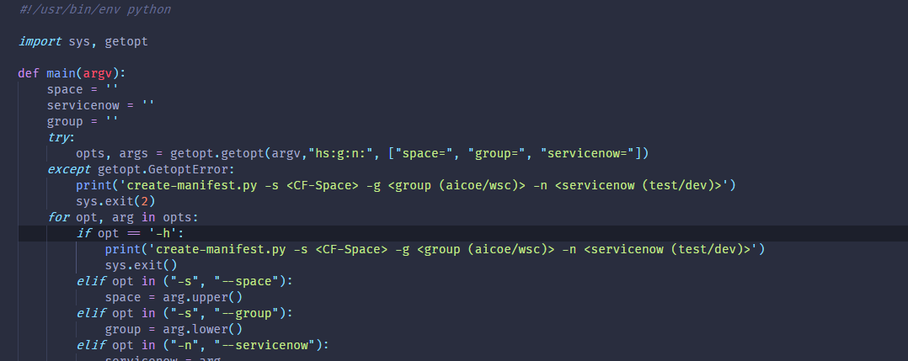
Python: Scripting
FOR INTERNAL USE ONLY
How we set up a script
Information classiﬁcation: Public

Slide 36
Python VSCode: Questions ?
FOR INTERNAL USE ONLY
So, use a IDE VSCode is vastly better than writing in a raw editor like notepad or eclipse…
And programming is hard enough already
Don’t make it necessary harder
* Disclaimer other IDEs than VSCode are good (cough cough … pycharm, cough cough … IntelliJ)
Information classiﬁcation: Public

Slide 37
Further Python Training:
FOR INTERNAL USE ONLY
Luckily we’re drowning in further resources here’s some further reading
Information classiﬁcation: Public

Slide 38
Further Python Training: AI CoE
FOR INTERNAL USE ONLY
xxxDELETEDxxx
Information classiﬁcation: Public

Slide 39
Further Python Training: Wider Natwest
FOR INTERNAL USE ONLY
xxxDELETEDxxx
Information classiﬁcation: Public

Slide 40
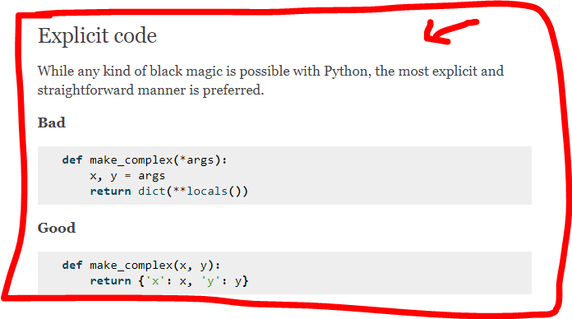
Further Python Training: Styling
FOR INTERNAL USE ONLY
Excellent guide on PEP-008 aka how to write “Python” style code
https://docs.python-guide.org/writing/style/
also
https://pep8.org/
https://www.python.org/dev/peps/pep-0008/
Information classiﬁcation: Public

Slide 41
Further Python Training: External
FOR INTERNAL USE ONLY
Tutorials by Google, as recommended by the python community
Sorting
https://developers.google.com/edu/python/sorting
Dicts and Files
https://developers.google.com/edu/python/dict-files
Regular Expressions (which are always useful, even to non Perl chaps)
https://developers.google.com/edu/python/regular-expressions
Utilities
https://developers.google.com/edu/python/utilities
Information classiﬁcation: Public

Slide 42
Further Python Training: External
FOR INTERNAL USE ONLY
Free Tutorials by Kaggle, as recommended by the NatWest data science community
Kaggle Challenge | Content
5 Day Challenge on Data Visualisation, Chi-Sq & T-test | Are you new to Data Science or need a quick refresher? This five day challenge will give you the guidance and support you need to kick-start your data science journey.
7 Day Challenge - Learn Python for first timers | This is a learn Python Challenge helping you to become familiar with the Python programming language.
5 Day Challenge - Data Cleansing | This challenge will help you handle missing values, scaling & normalisation, parsing dates, character encoding and manage inconsistent data entry.
Information classiﬁcation: Public

Slide 43
Questions?
FOR INTERNAL USE ONLY
I’ve been Anthony M^{c}Kale “Wizard without Portfolio” Fixer-Upper of Broken things, and creator of time-constrained workable Fudges for 15 years. Email : anthony@zapper.hodgers.com
Information classiﬁcation: Public

Slide 44
FOR INTERNAL USE ONLY
Thank you
Information classiﬁcation: Public

